Slide 1

Capstone project 2
NYC TAXI TRIP TIME PREDICTION
Team Project
Ansh Bhatnagar
Sandeep Kumar Maurya

Slide 2
CONTENT
Introduction
Problem statement
Data summary
Exploratory Data Analysis (EDA)
Feature Engineering & Selection
Building and Evaluating Model
Conclusion

Slide 3
INTRODUCTION
In New York City, due to traffic jams, construction or road blockage etc. user will need to know how much time it will take to commute from one place to other.
Increasing popularity of app-based taxi such as ola or uber and there competitive pricing levels made user decisive to choose based on trip pricing and duration.
Taxi Drivers also have to choose best route having lesser trip time.
So here we will be building a model which will be predicting the trip duration of taxies running in NewYork. This prediction will help customers to select the taxi based on trip duration and driver to select optimum route to their destination.

Slide 4
PROBLEM STATEMENT
We have the dataset Which is based on the 2016 NYC Yellow Cab trip record data made available in Big Query on the Google Cloud Platform. The data was originally published by the NYC Taxi and Limousine Commission (TLC). The data was sampled and cleaned for the purposes of this project. Based on individual trip attributes, we should predict the duration of each trip in the test set.

Slide 5
DATA SUMMARY
id - a unique identifier for each trip
vendor_id - a code indicating the provider associated with the trip record
pickup_datetime - date and time when the meter was engaged
dropoff_datetime - date and time when the meter was disengaged
passenger_count - the number of passengers in the vehicle (driver
entered value)
pickup_longitude - the longitude where the meter was engaged
pickup_latitude - the latitude where the meter was engaged
dropoff_longitude - the longitude where the meter was disengaged
dropoff_latitude - the latitude where the meter was disengaged
store_and_fwd_flag - This flag indicates whether the trip record was held in vehicle memory before sending to the vendor because the vehicle did not have a connection to the server - Y=store and forward; N=not a store and forward trip
trip_duration - duration of the trip in seconds

Slide 6
BASIC EXPLORATION
The dataset contains 1458644 rows and 11 columns.
Two categorical features ‘store_and_fwd_flag’ and ‘vendor_id’
Outliers present in all numerical features
Data formating steps required for datetime features
No null values present
Passenger_count, Vendor_id and trip_duration are having integer value.
pickup_datetime,dropoff_datetime is a datetime variable
pickup_longitude,pickup_latitude,dropoff_longitude,dropoff_latitude
are real numbers having float as data type *store_and_fwd_flag
and Id belongs to a string data type.

Slide 7
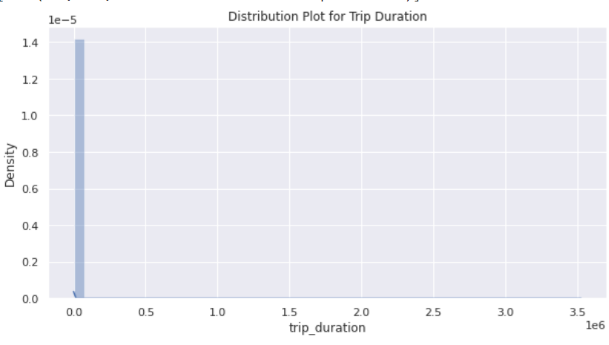
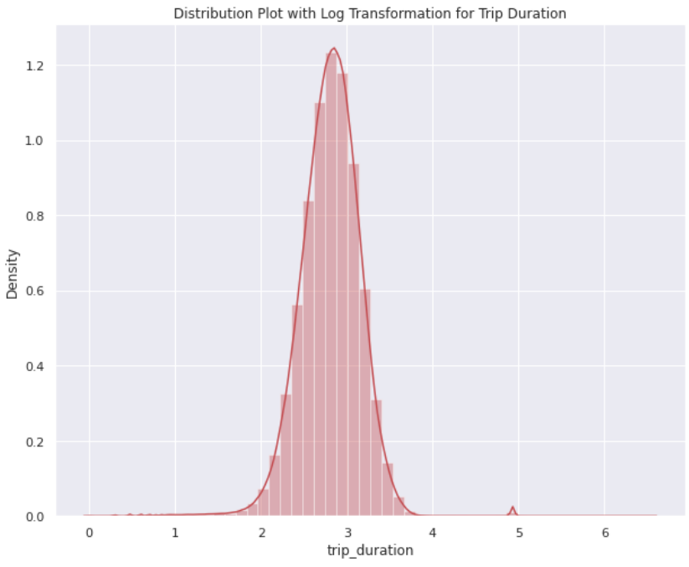
TRIP DURATION DATA ANALYSIS

Slide 8
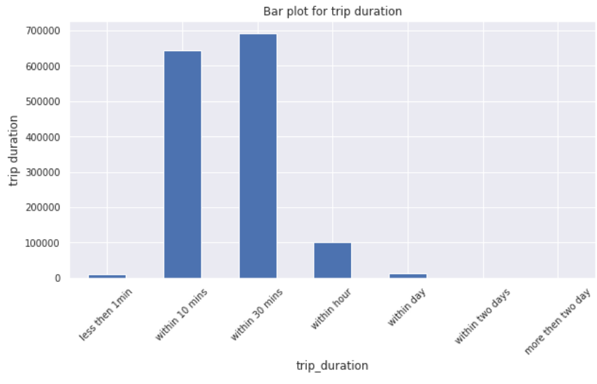
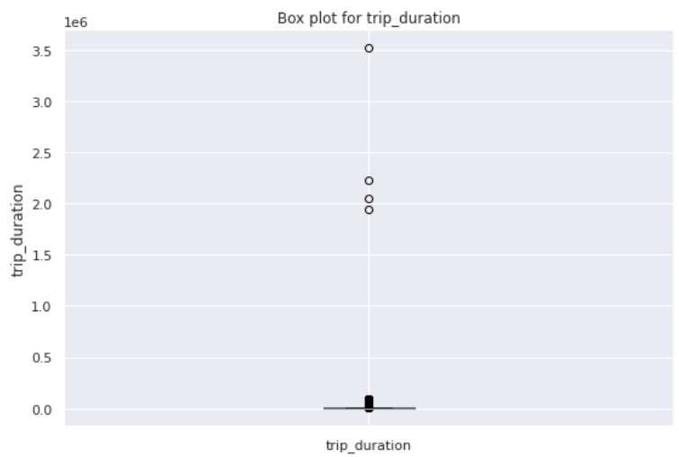
TRIP DURATION DATA ANALYSIS
From the figure above we can conclude that most of the trip are general for 10 min to 1 hour.

Slide 9
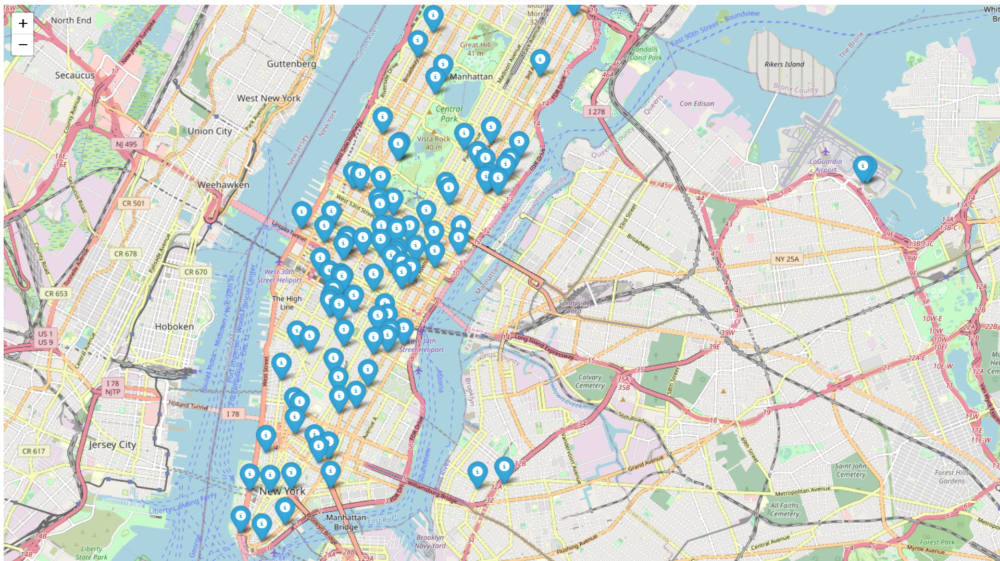
Distribution of Pickup Latitude and longitude

Slide 10
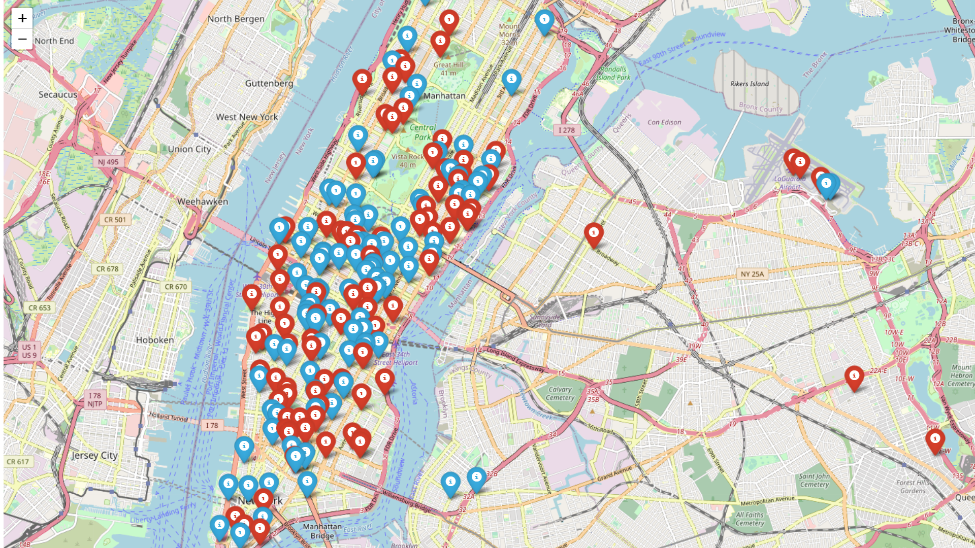
Distribution of Dropoff Latitude and longitude

Slide 11
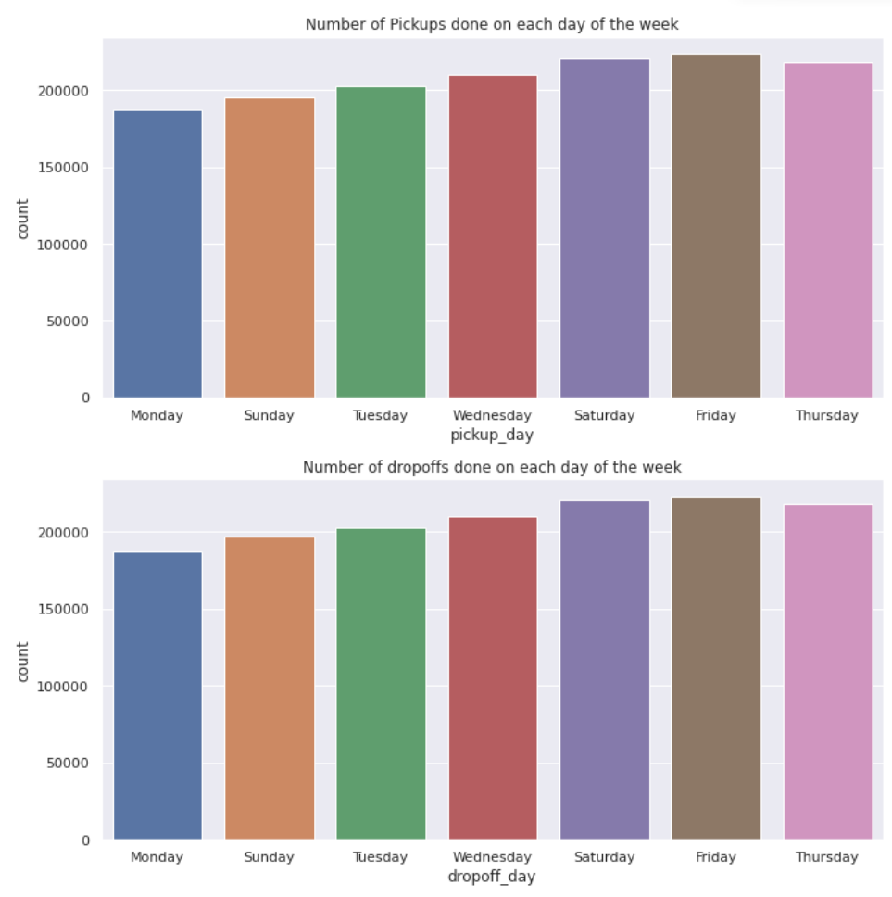
Number of Pickups and Drop-offs with in a Week

Slide 12
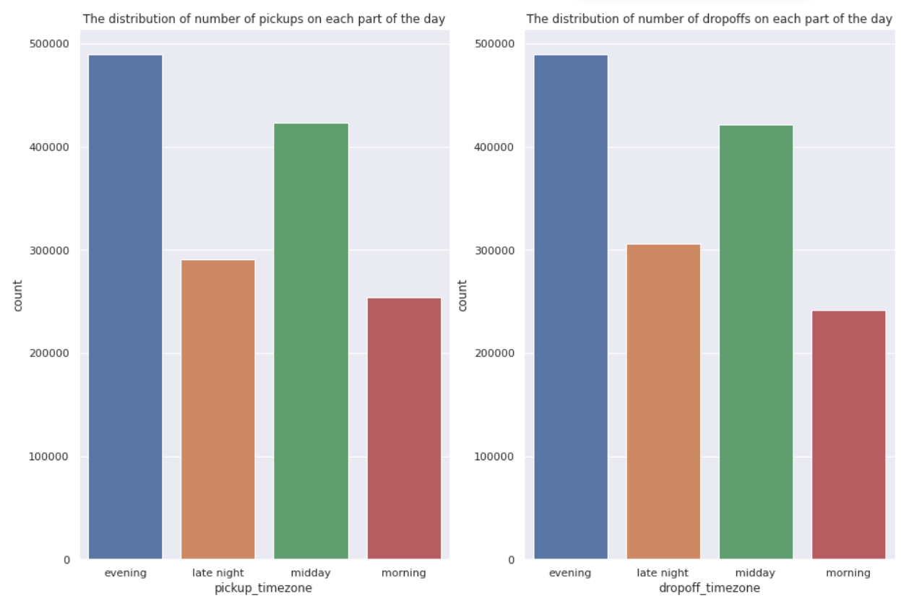
Number of Pickups and Drop-offs with in a Day

Slide 13
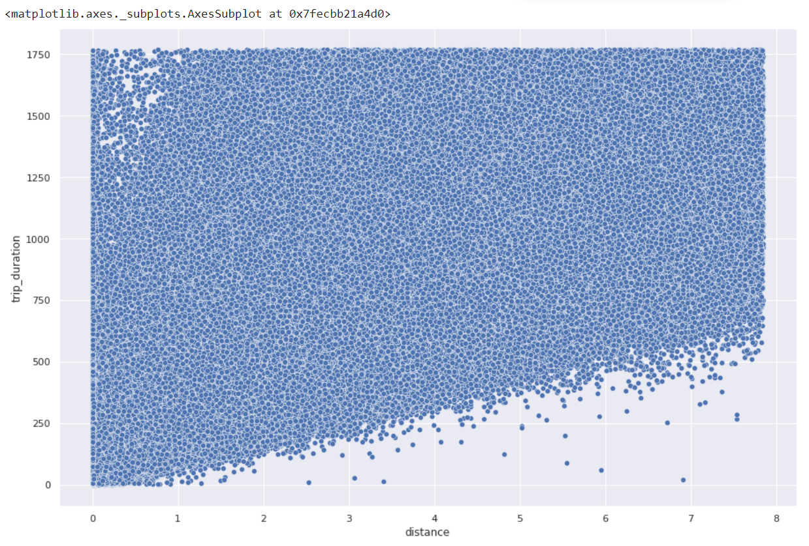
Relation Between Trip duration and Distance

Slide 14
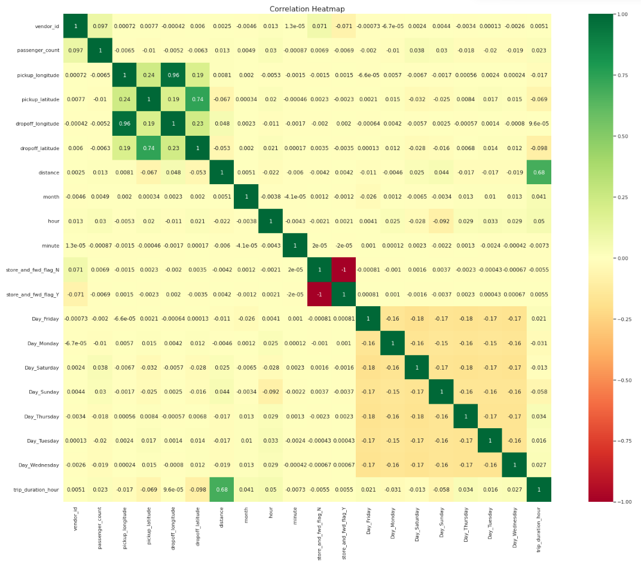
Correlation Heatmap

Slide 15
Evaluation Metrics
Evaluation metrics are used to measure the quality of the statistical or machine learning model. Evaluating machine learning models or algorithms is essential for any project. There are many different types of evaluation metrics available to test a model.
Why We require Evaluation Metrics?
Most beginners and practitioners most of the time do not bother about the model performance. The talk is about building a well-generalized model, Machine learning model cannot have 100 per cent efficiency otherwise the model is known as a biased model. which further includes the concept of overfitting and underfitting.
It is necessary to obtain the accuracy on training data, But it is also important to get a genuine and approximate result on unseen data otherwise Model is of no use.
So to build and deploy a generalized model we require to Evaluate the model on different metrics which helps us to better optimize the performance, fine-tune it, and obtain a better result.
If one metric is perfect, there is no need for multiple metrics. To understand the benefits and disadvantages of Evaluation metrics because different evaluation metric fits on a different set of a dataset.

Slide 16
Different Evaluation metrics
1) Mean Absolute Error(MAE)
MAE is a very simple metric which calculates the absolute difference between actual and predicted values.
2) Mean Squared Error(MSE)
MSE is a most used and very simple metric with a little bit of change in mean absolute error. Mean squared error states that finding the squared difference between actual and predicted value.
3) Root Mean Squared Error(RMSE)
As RMSE is clear by the name itself, that it is a simple square root of mean squared error.
4) R Squared (R2)
R2 score is a metric that tells the performance of your model, not the loss in an absolute sense that how many wells did your model perform.
5) Adjusted R2
Adjusted R2 is a corrected goodness-of-fit (model accuracy) measure for linear models. It identifies the percentage of variance in the target field that is explained by the input or inputs.

Slide 17
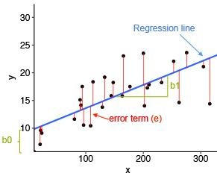
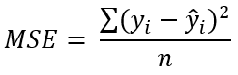
Linear Regression
Linear Regression is a regression of dependent variable on independent variable. It is a linear model that assumes a linear relationship between dependent
(y) and independent variables (x). The dependent variable (y) is calculated by l inear combination of independent variable (x).
y=b₀+b₁ x₁ +b₂x₂
The cost function for linear regression is given by:
Mean of sum of square error
MSE | 72764.0061
RMSE | 269.748041
R2 | 0.484766
Adjusted_R2 | 0.484758
Where:
y_{i} is the i^{th} observed value.
ŷ_{i} is the corresponding predicted value.
n = the number of observations.

Slide 18
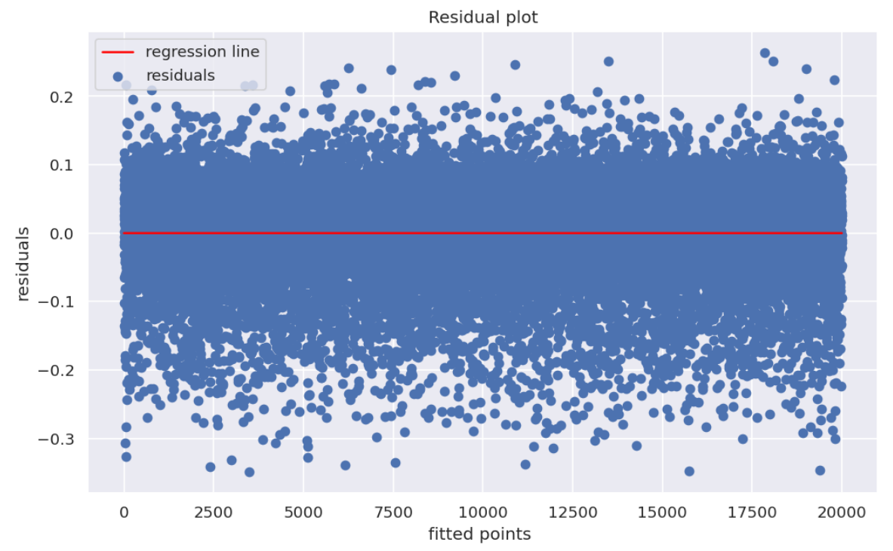
Homoscedasticity check

Slide 19
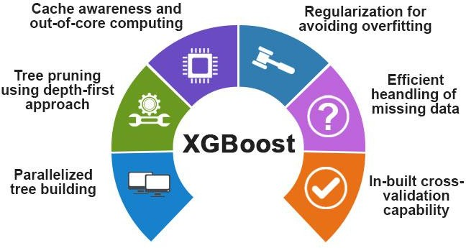
XGBoost
XGBoost comes under boosting and is known as extra gradient boosting.
GBM first calculates the model using X and Y then after the prediction is obtain.
It will again calculates the model based on residual of previous model
loss function will give more weightage to error of previous model. and this process continuous until MSE gets minimizes.
XGBoost is just an extension of GBM with following advantages.
Regularization
Parallel Processing
High Flexibility
Handles Missing values
Tree pruning
Buitin cross validation
Continuous on existing model
MSE | 0.001963
RMSE | 0.044311
R2 | 0.822151
Adjusted_R2 | 0.822109

Slide 20

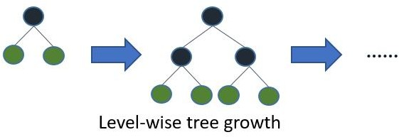
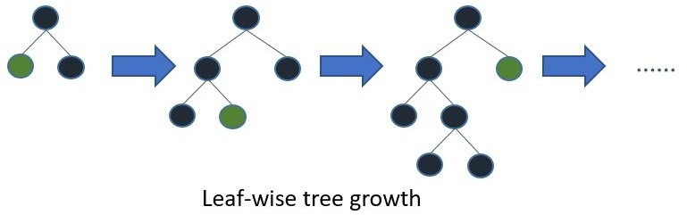
LightGBM
LightGBM is a fast, distributed high performance gradient boosting framework.
LightGBM is based on decision tree algorithm. But it splits the tree leaf wise rather then level wise like other boosting algorithm. So when growing on the same leaf in Light GBM, the leaf- wise algorithm can reduce more loss than the level-wise algorithm and hence results in much better accuracy which can rarely be achieved by any of the existing boosting algorithms.
MSE | 56602.8129
RMSE | 237.913456
R2 | 0.599202
Adjusted_R2 | 0.599196

Slide 21
Feature Importance
Feature Importance refers to techniques that calculate a score for all the input features for a given model — the scores simply represent the “importance” of each feature. A higher score means that the specific feature will have a larger effect on the model that is being used to predict a certain variable.
Let’s take a real-life example for a better understanding. Suppose you have to buy a new house near your workplace. While purchasing a house, you might think of different factors. The most important factor in your decision making might be the location of the property, and so, you’ll likely only look for houses that are near your workplace. Feature importance works in a similar way, it will rank features based on the effect that they have on the model’s prediction.

Slide 22
Feature Importance
Why is Feature Importance so Useful?
Feature Importance is extremely useful for the following reasons:
1) Data Understanding.
Building a model is one thing but understanding the data that goes into the model is another. Like a correlation matrix, feature importance allows you to understand the relationship between the features and the target variable. It also helps you understand what features are irrelevant for the model.
2) Model Improvement.
When training your model, you can use the scores calculated from feature importance to reduce the dimensionality of the model. The higher scores are usually kept and the lower scores are deleted as they are not important for the model. This not only makes the model simpler but also speeds up the model’s working, ultimately improving the performance of the model.
3) Model Interpretability.
Feature Importance is also useful for interpreting and communicating your model to other stakeholders. By calculating scores for each feature, you can determine which features attribute the most to the predictive power of your model.

Slide 23
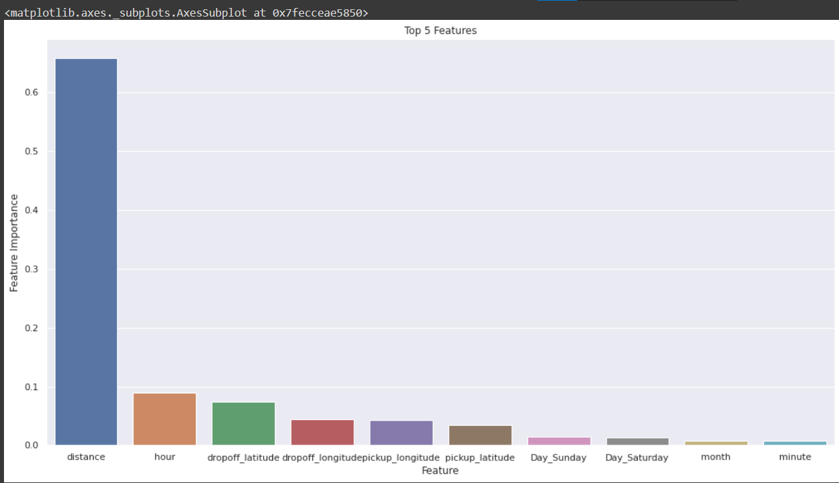
Feature Importance
Fig above illustrate that the most important feature detect by the XGBOOST algorithm is distance

Slide 24
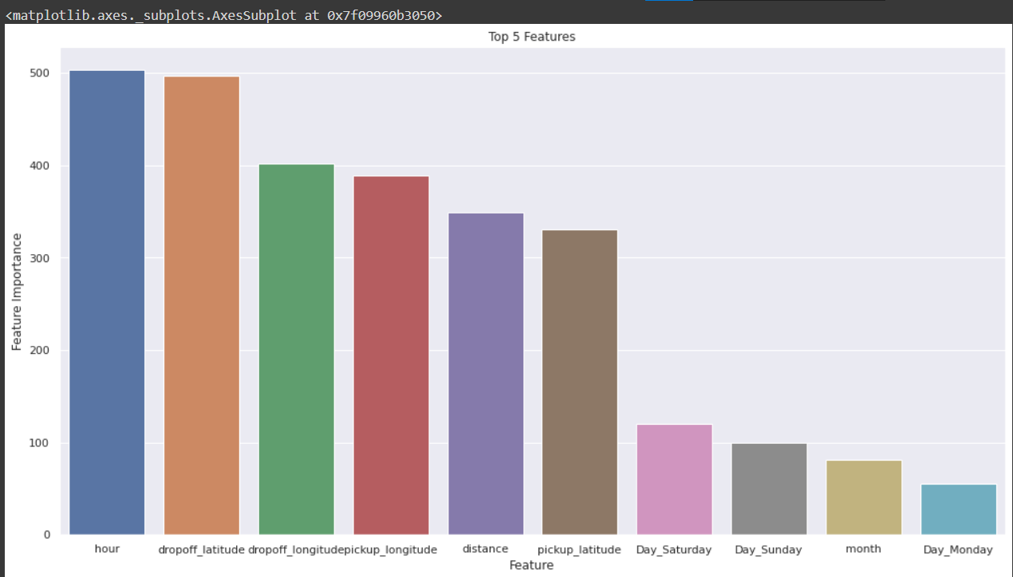
Feature Importance
Fig above illustrate that the most important feature detect by the LightGBM algorithm is hour

Slide 25
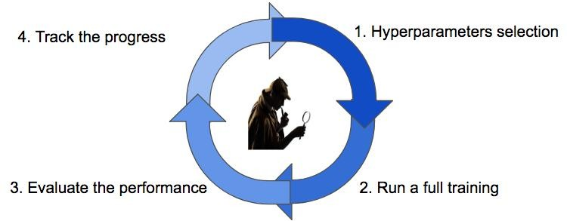
Hyperparameter Tuning
Hyperparameters are sets of information that are used to control the way of learning an algorithm.
We used Grid Search CV, for hyperparameter tuning. This also results in cross-validation and in our case we divided the dataset into different folds
Hyperparameters | XGB | LightGBM
n_estimator | [5,10,20] | [5,10,20]
max_depth | [5,7,9] | [5,7,9]
min_samples_split | [40,50] | [40,50]
cv | 3 | 3
eval_Score | R2 | R2
Metric | XGB | LightGBM
MSE | 103672.2 | 103515.51
RMSE | 321.98 | 321.74
R2 | 0.6933 | 0.6938
Adjusted_R2 | 0.6857 | 0.6862

Slide 26
Final Metrics Conclusion
Algorithms | Test MSE | Test RMSE | Test R2 | Train Adjusted R2
Linear Regression | 0.005472 | 0.073978 | 0.495791 | 0.495312
Lasso Regression | 0.005470 | 0.073965 | 0.495963 | 0.495484
Ridge Regression | 0.005470 | 0.073965 | 0.495966 | 0.495486
Decision Tree Regressor | 0.004235 | 0.065081 | 0.609772 | 0.609401
XGB Regressor | 0.003144 | 0.056076 | 0.710290 | 0.710014
Gradient Boosting | 0.003121 | 0.055870 | 0.712415 | 0.712142
Light GBM | 0.003418 | 0.058470 | 0.685021 | 0.684722
Reference
R2-score: Usually must be between 0 and 1, towards 1 considered as good fit.
RMSE: [Value] <= 0.1146 (Null RMSLE - A Benchmark to Achieve)

Slide 27
Conclusion
In this project, we tried to predict the trip duration of a taxi in NYC.
We are mostly concerned with the information of pick up latitude and longitude and drop off latitude and longitude, to get the distance of the trip.
Hyperparameter tuning doesn’t improve much accuracy.
Linear regression gives 60.89 % accuracy,XGBoost gives 68.56% accuracy, LightGBM gives 71.42% on the test set.
LightGBM is more fitter and efficient than XGBoost for taxi trip duration-based predictions
LightGBM will be the best model to predict the trip duration for a particular taxi.

Slide 28
Challenges
Handling Large Dataset
Feature Engineering
Computation Time
Optimising The Model

